Slide 1
Project Epiphyte
Webinar 11/2/23
Epiphyte Build Progress
First evidence of CO2 (and H2O) capture
Measurement Issues!

Slide 2
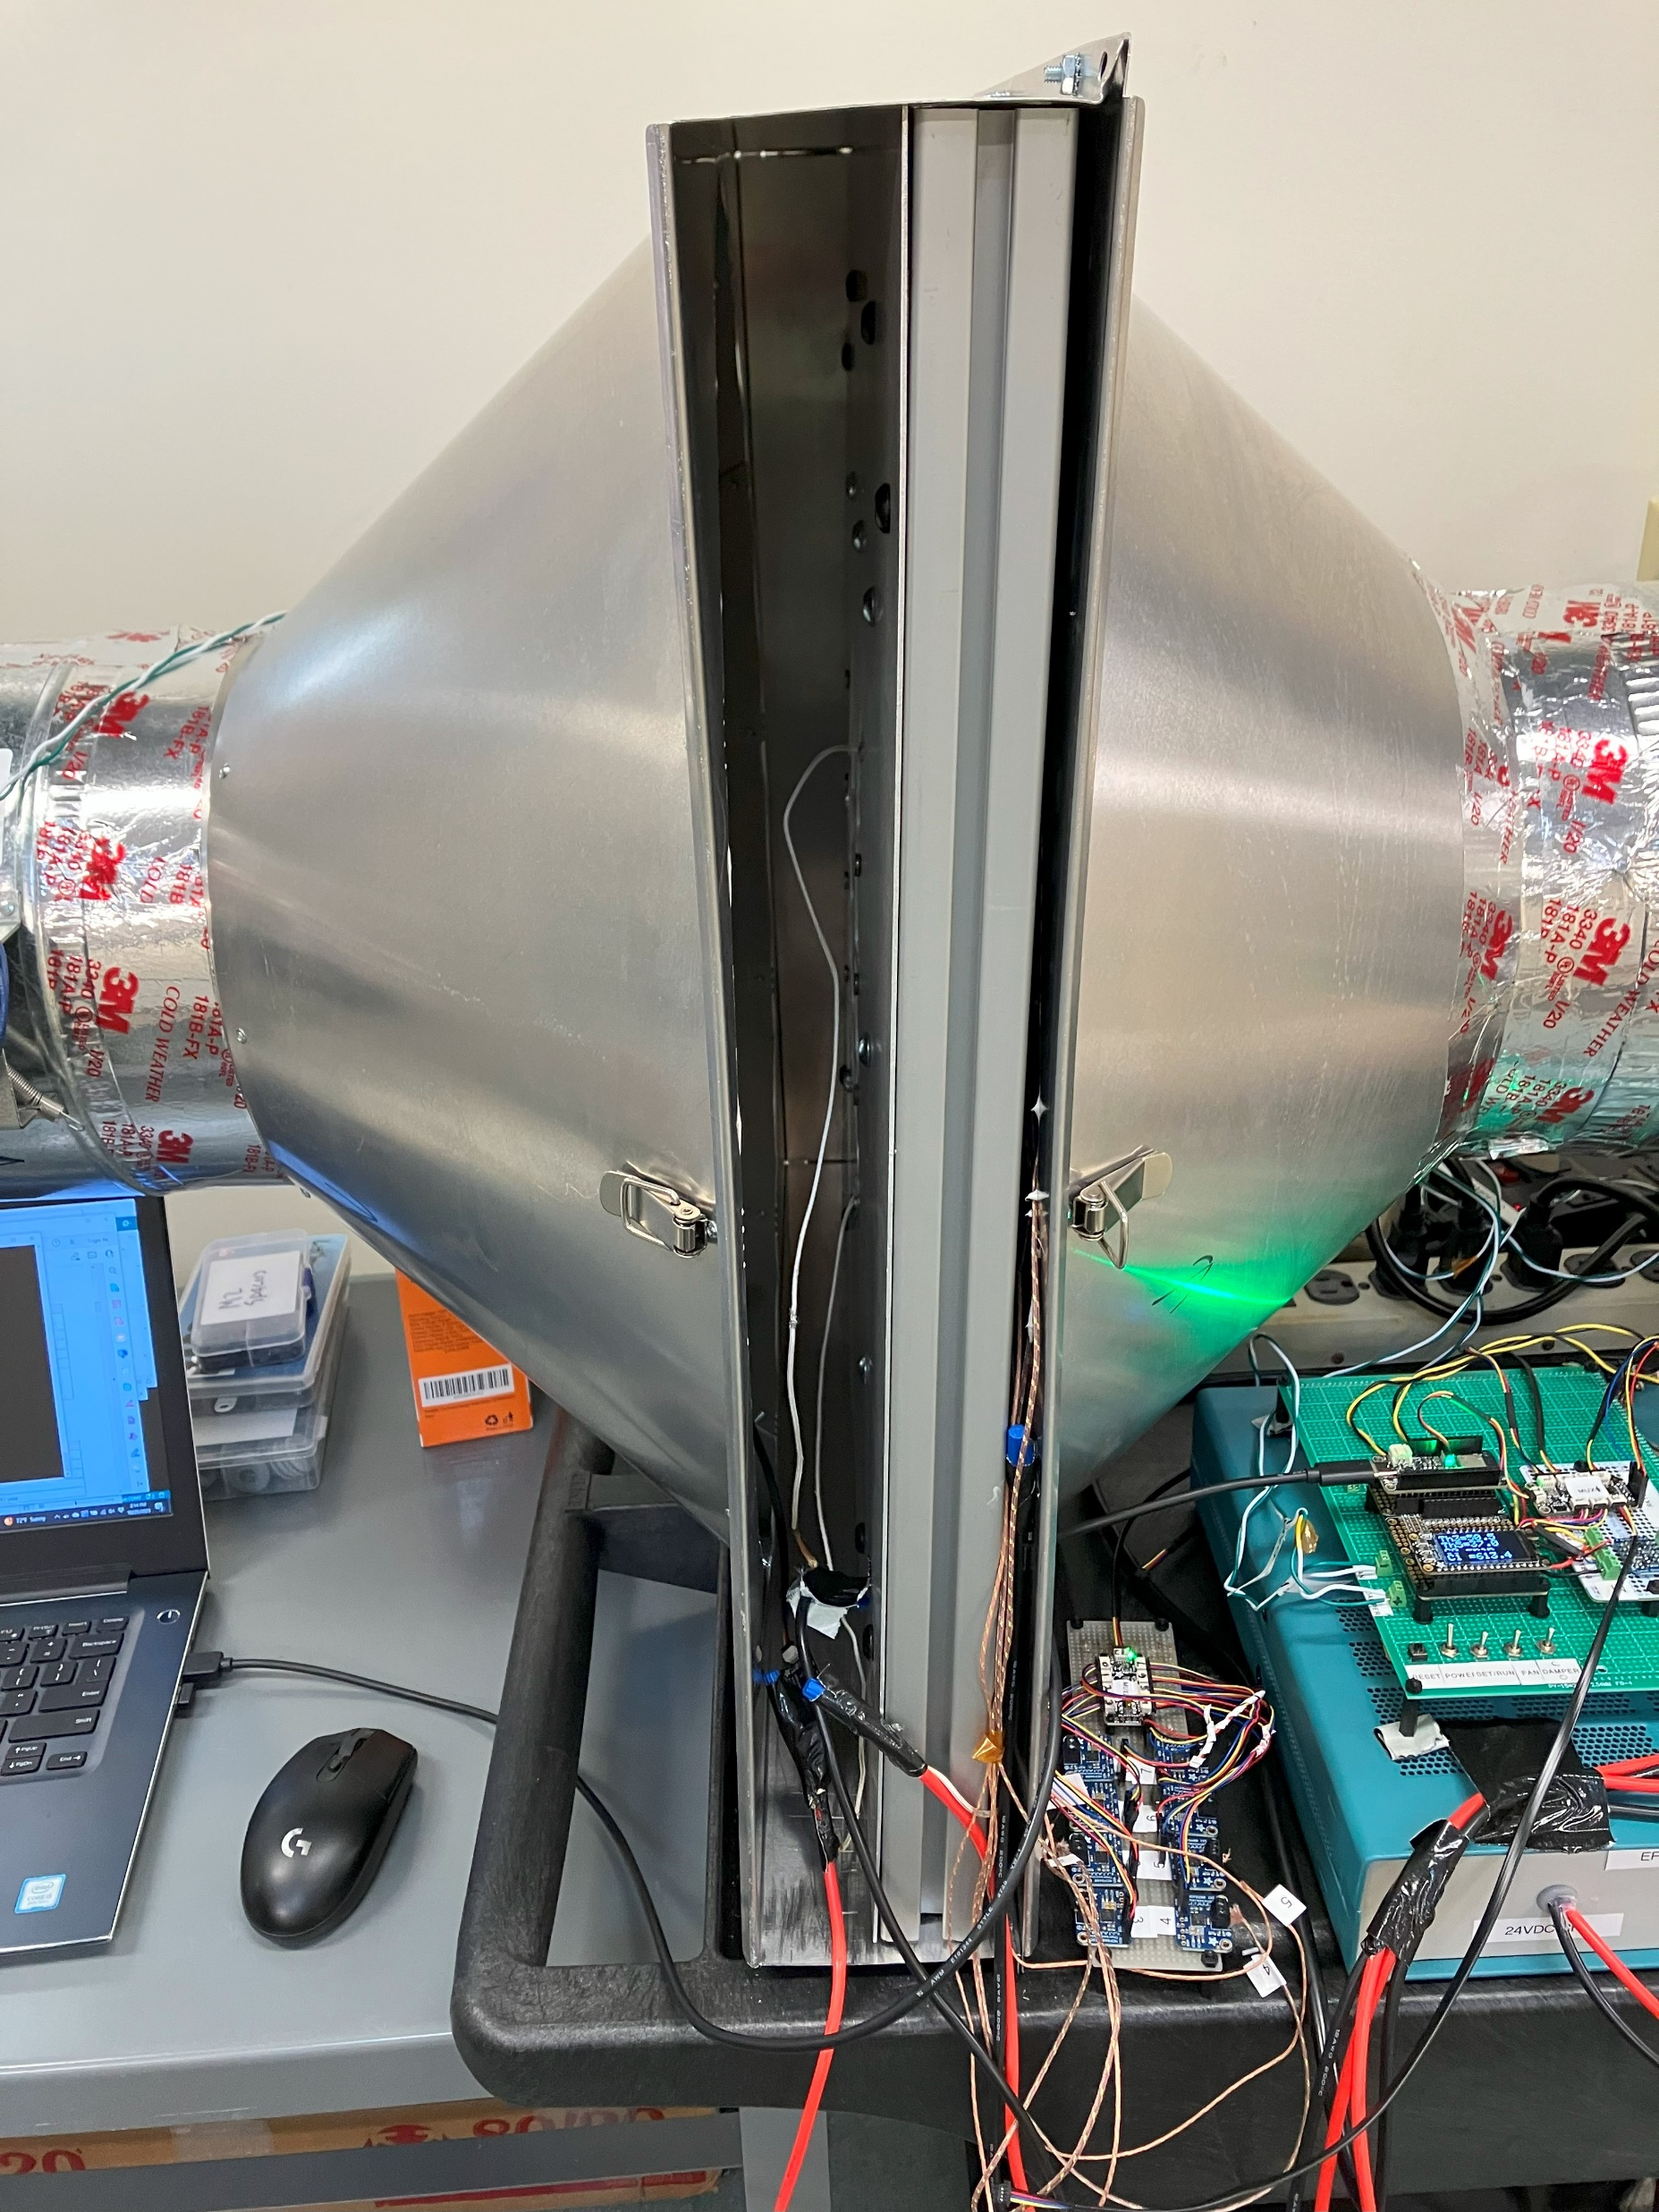
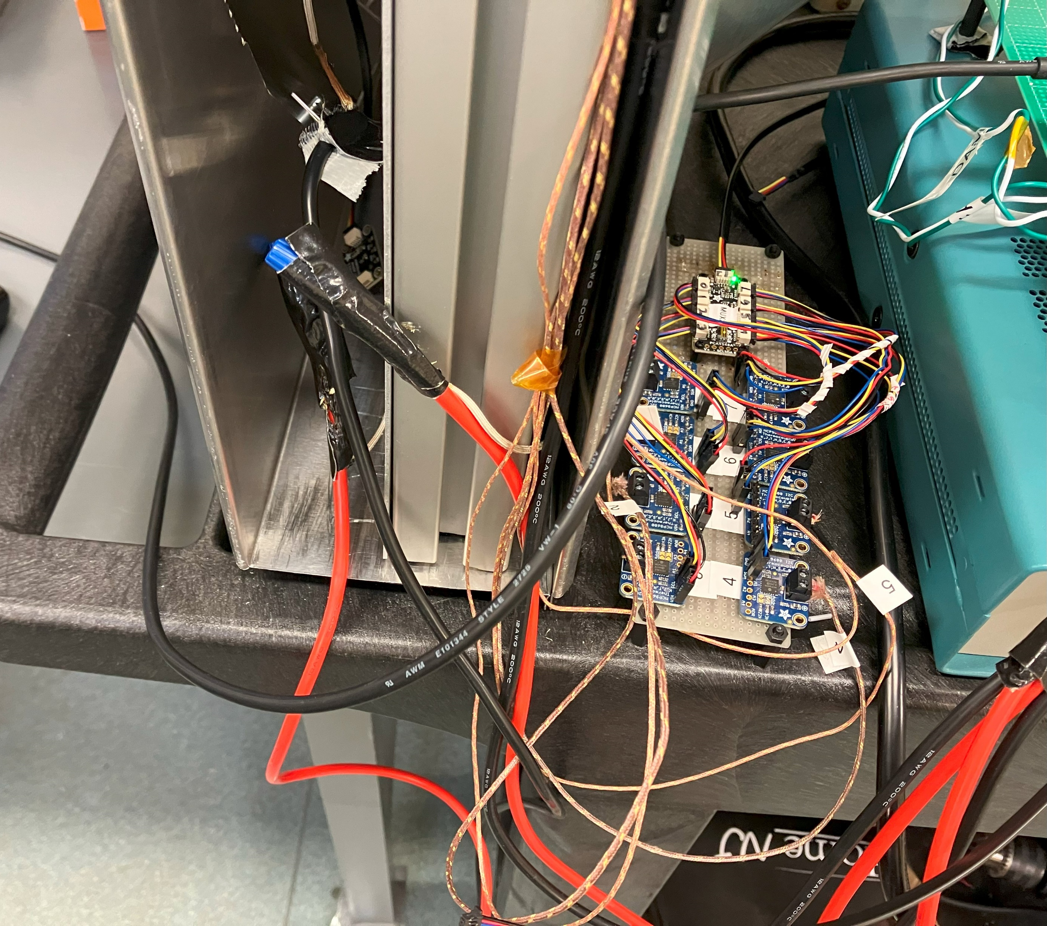
Sorbent Panel Cleanup
Before…

Slide 3
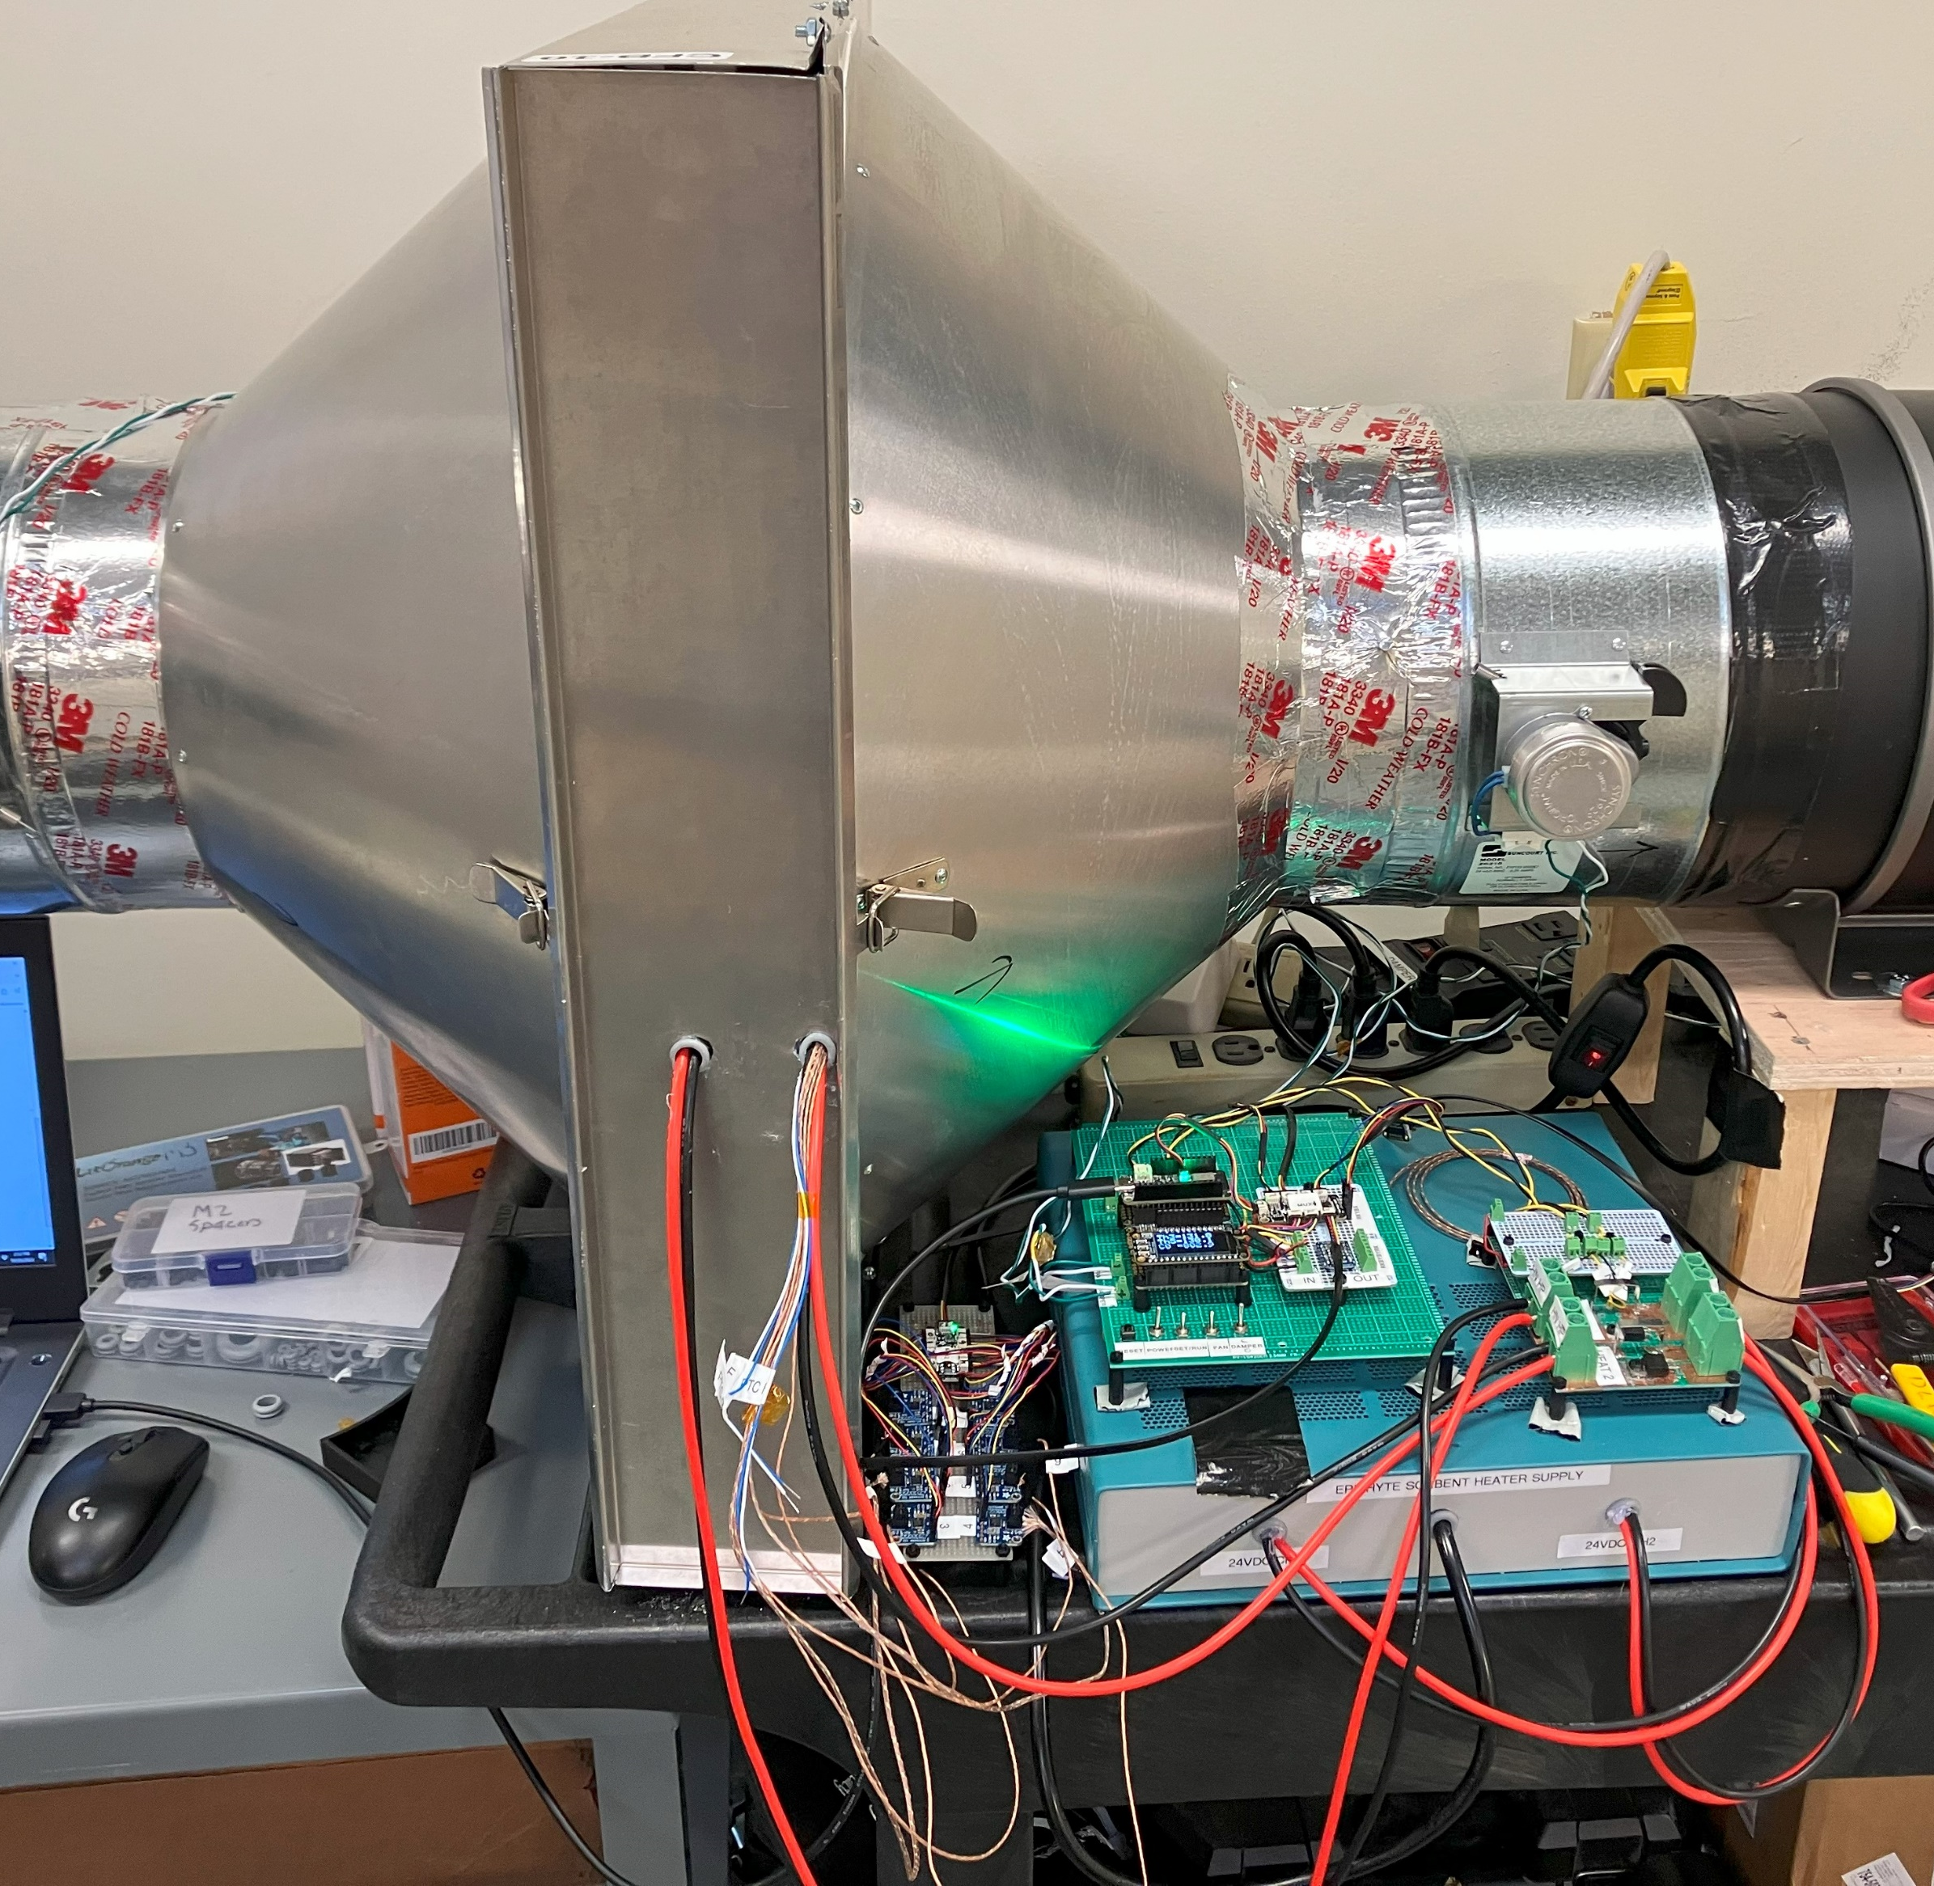
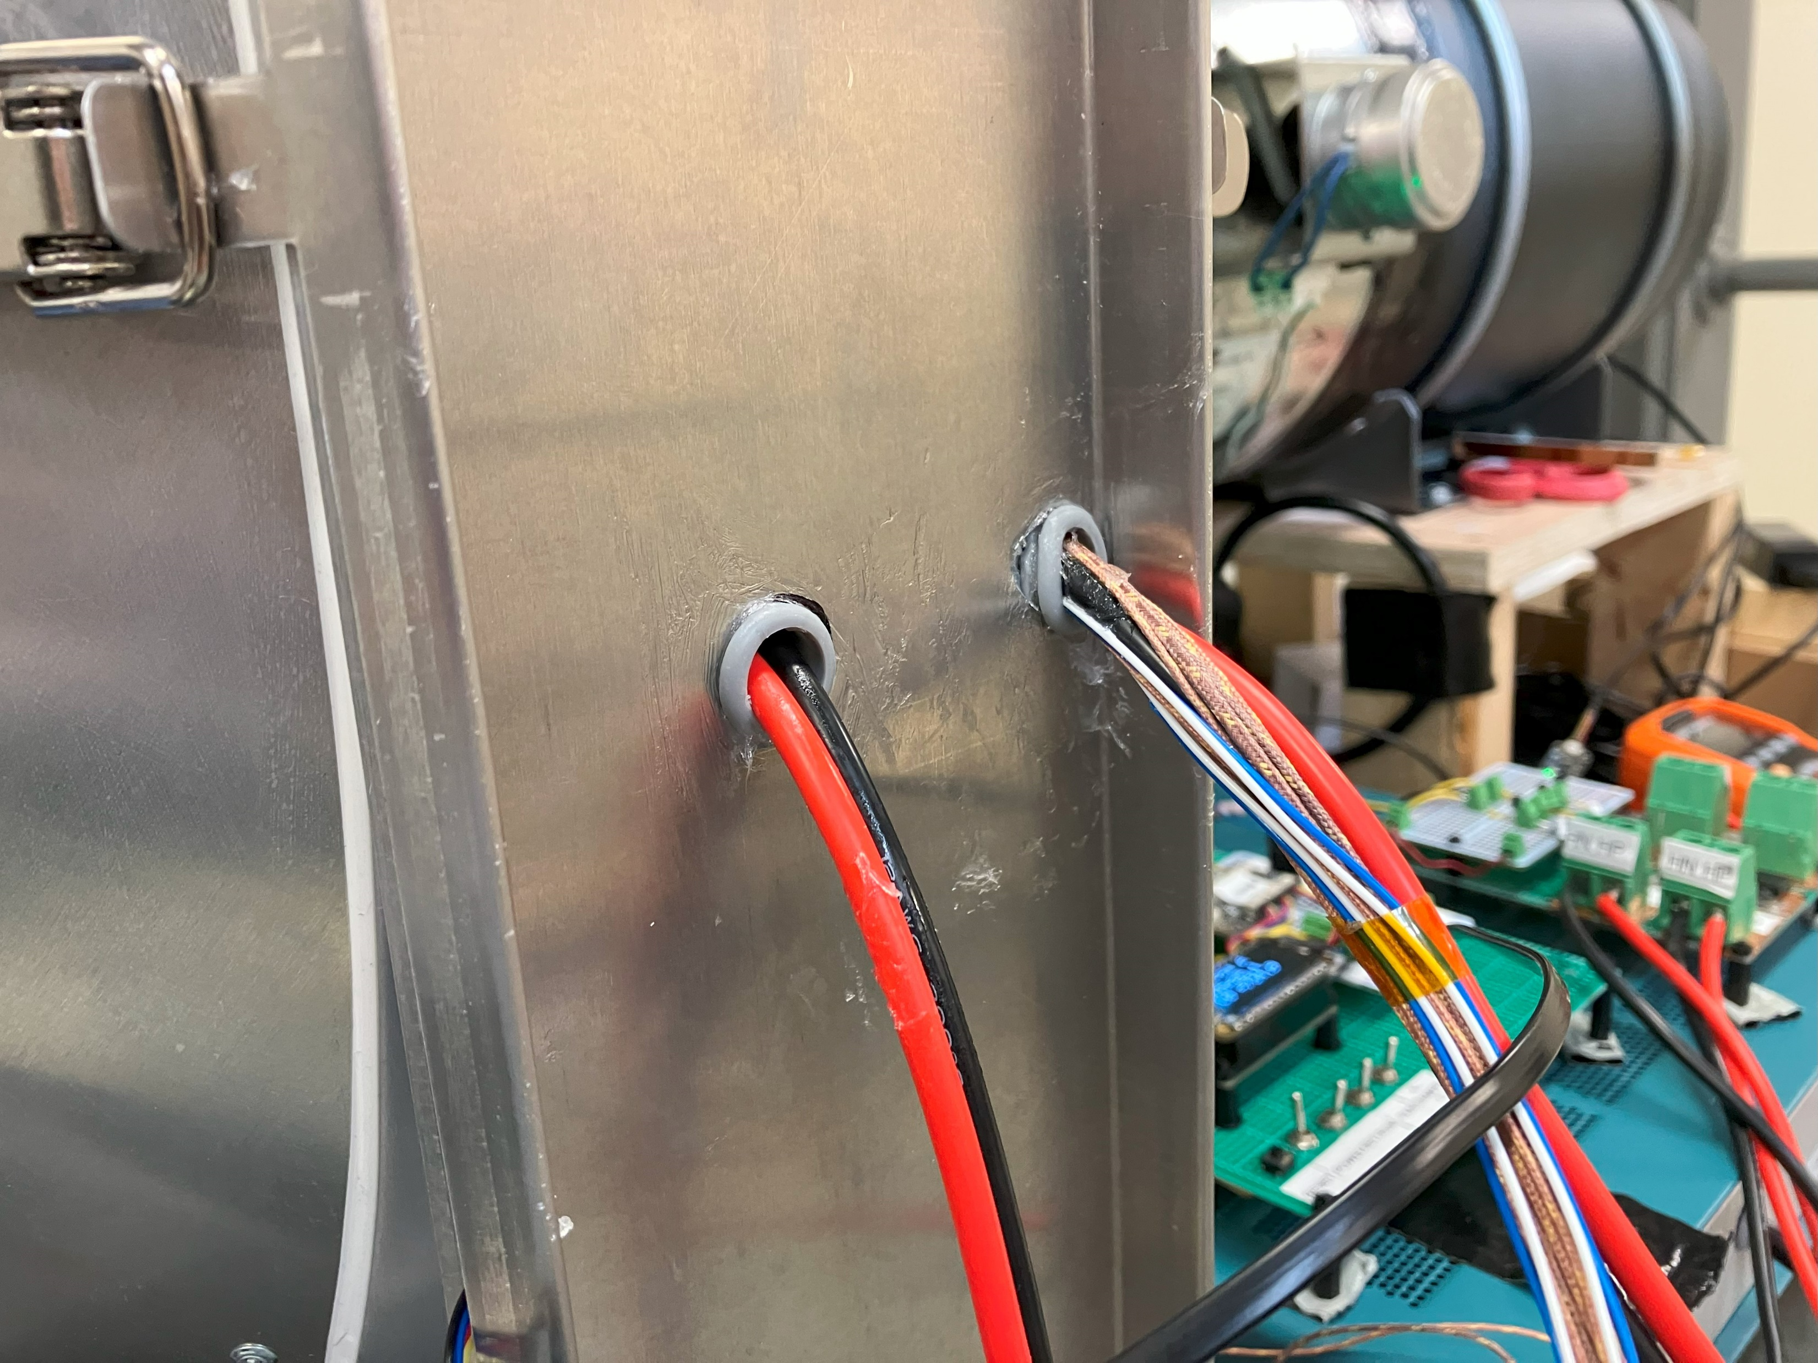
Sorbent Panel Cleanup
After!

Slide 4
EPIPHYTE CO2 CAPTURE SEQUENCE:
(1) ADSORPTION
DAMPER 1
DAMPER 2
FAN
OPEN
SORBENT PANEL
C
C
OPEN
ON
HEATER OFF
C
CO2, HUMIDITY, AND TEMP
AIR IS BLOWN THROUGH
CO2 IS CAPTURED BY SORBENT

Slide 5
(2) DESORPTION: Heat Only
DAMPER 1
DAMPER 2
FAN
T
CLOSED
CLOSED
C
T
T
OFF
C
T
HEATER ON
T
TEMPERATURE
C
CO2, HUMIDITY, AND TEMP

Slide 6
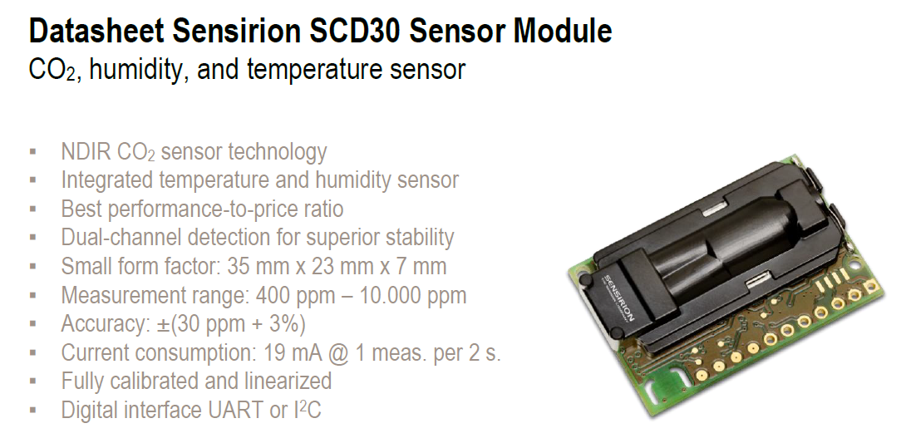
CO2 Sensor

Slide 7
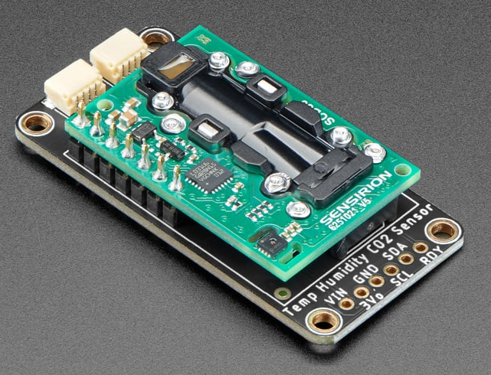
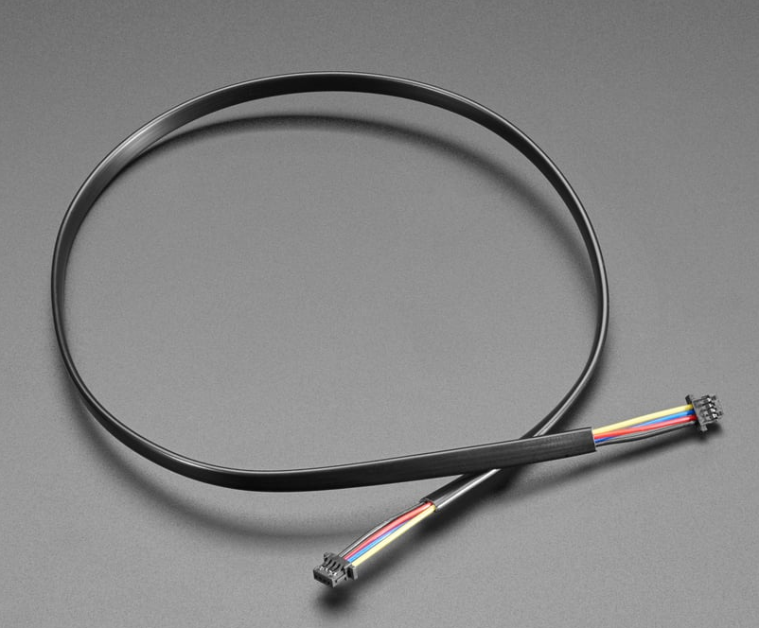
Adafruit Breakout Board with Stemma QT Connectors for I2C

Slide 8
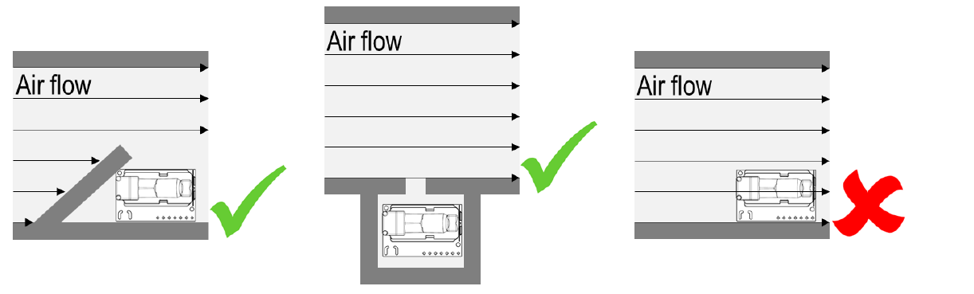
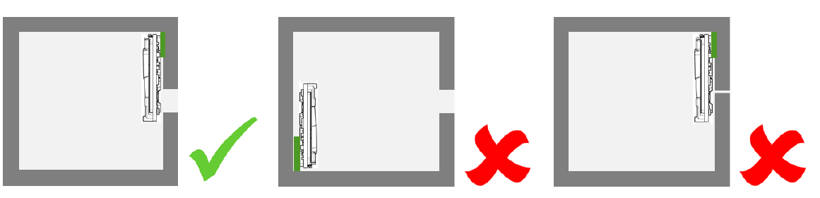
Mounting Requirement for Sensor

Slide 9
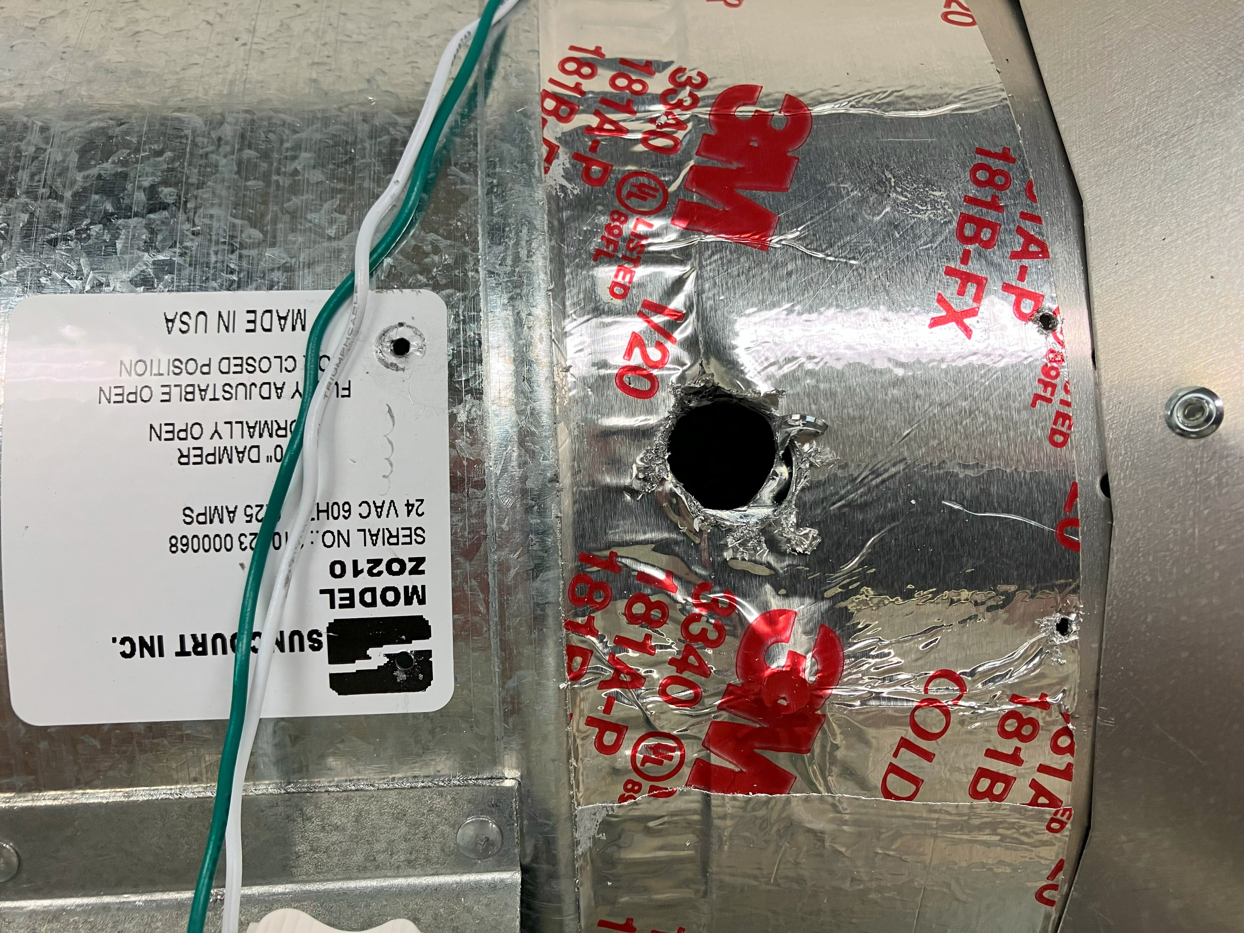
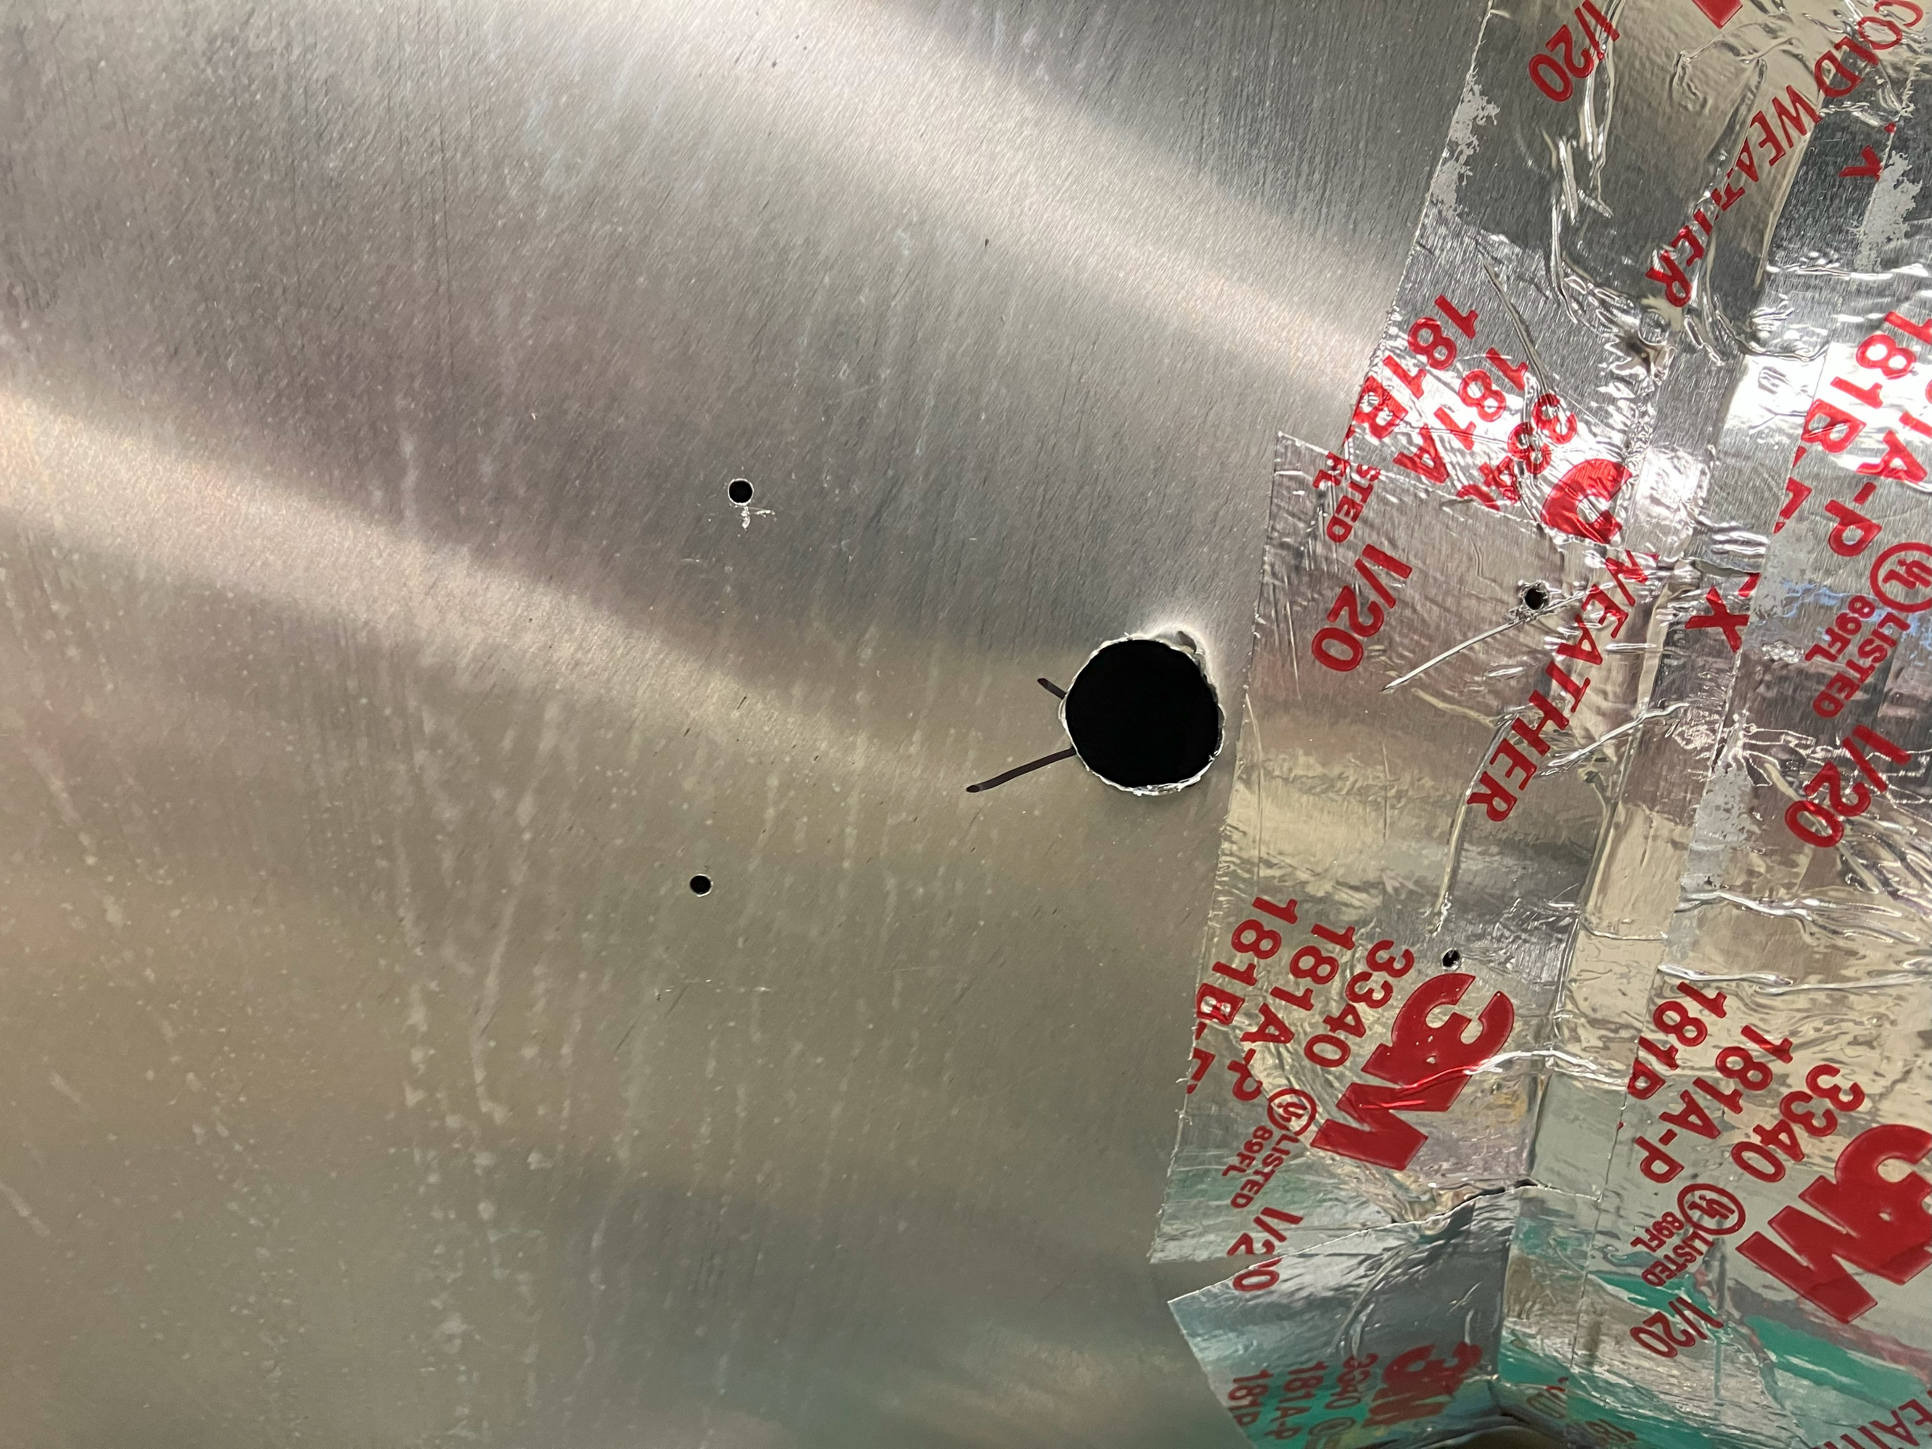
Holes in Duct

Slide 10
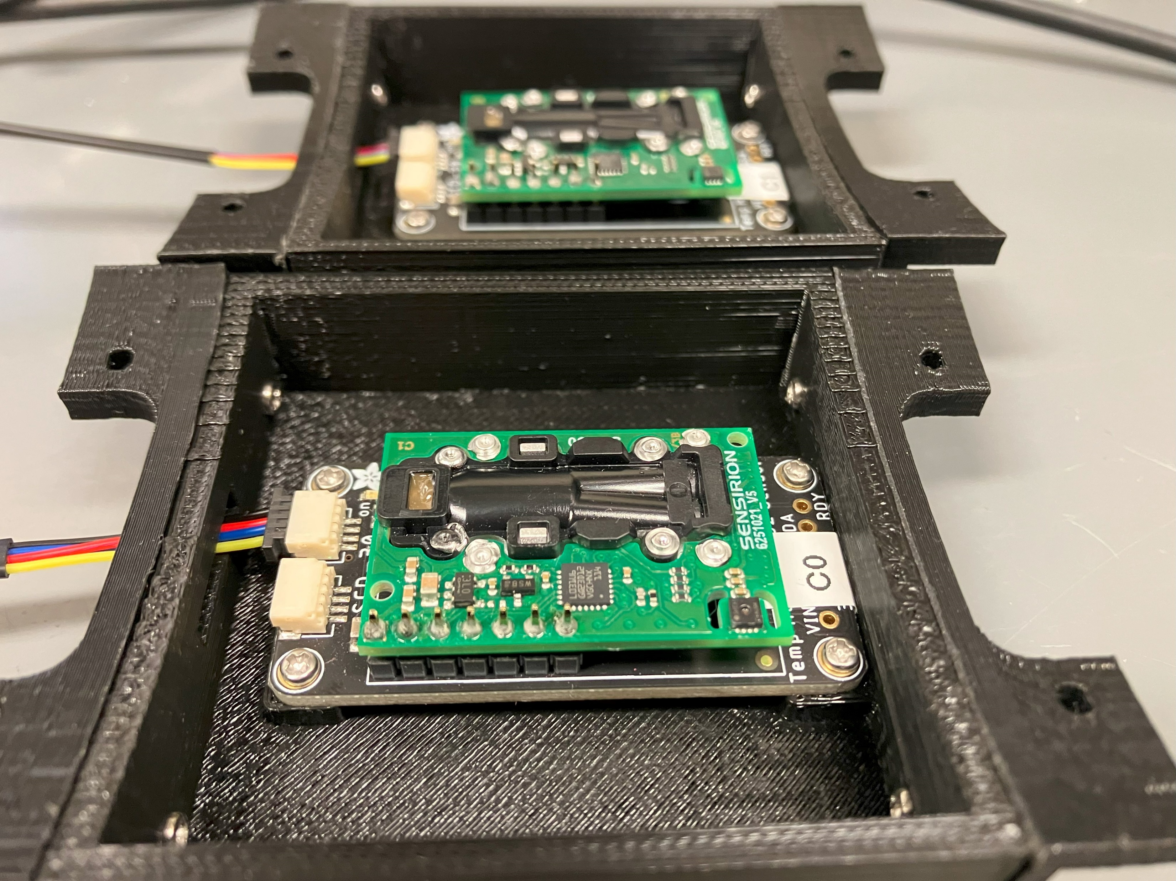
Sensor Boxes (Thanks to Ling)

Slide 11
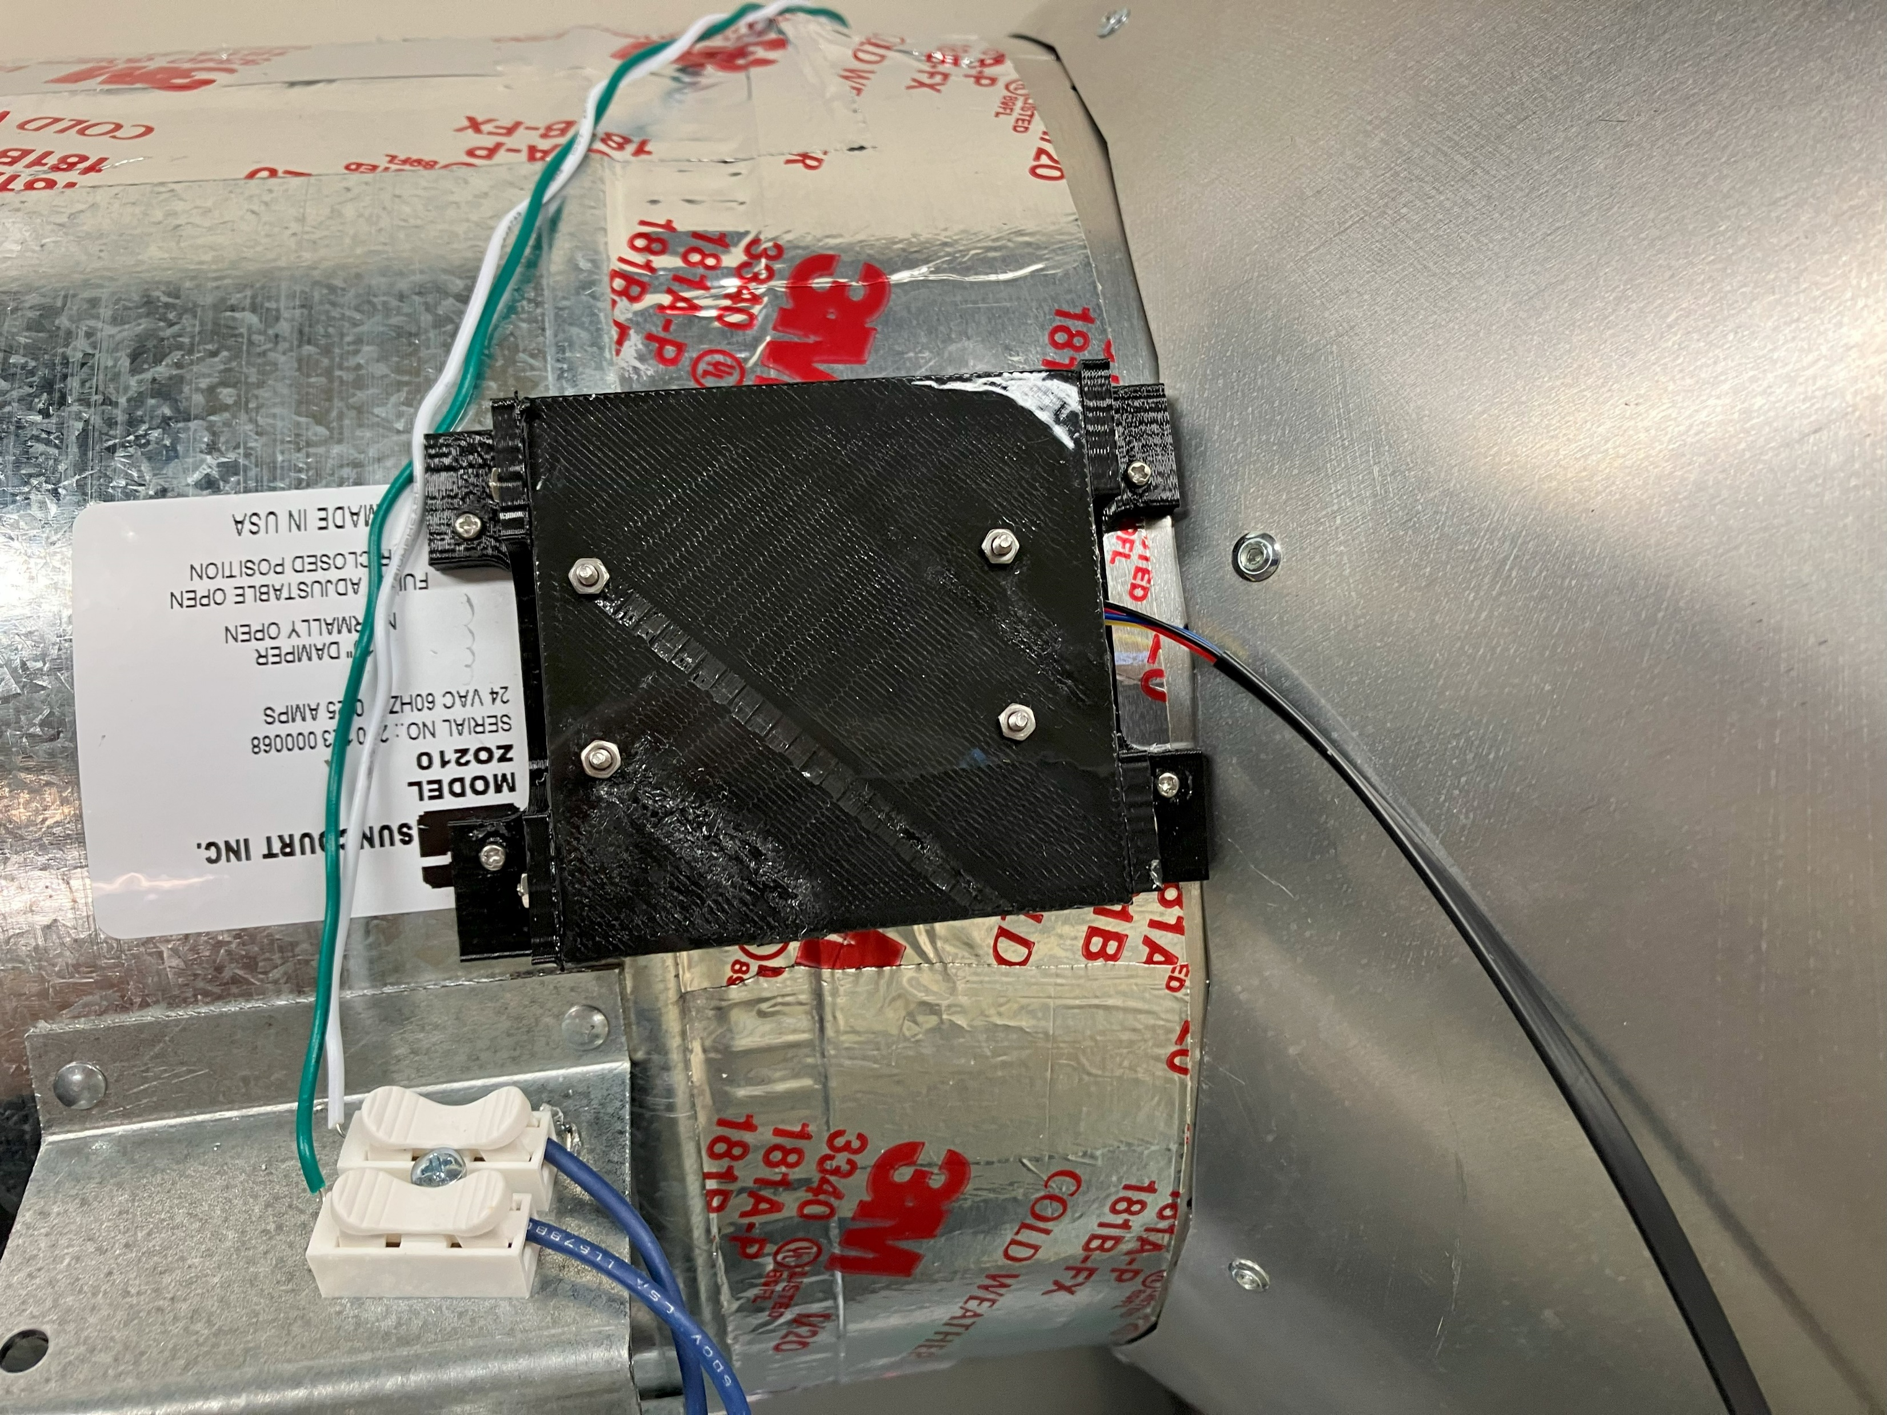
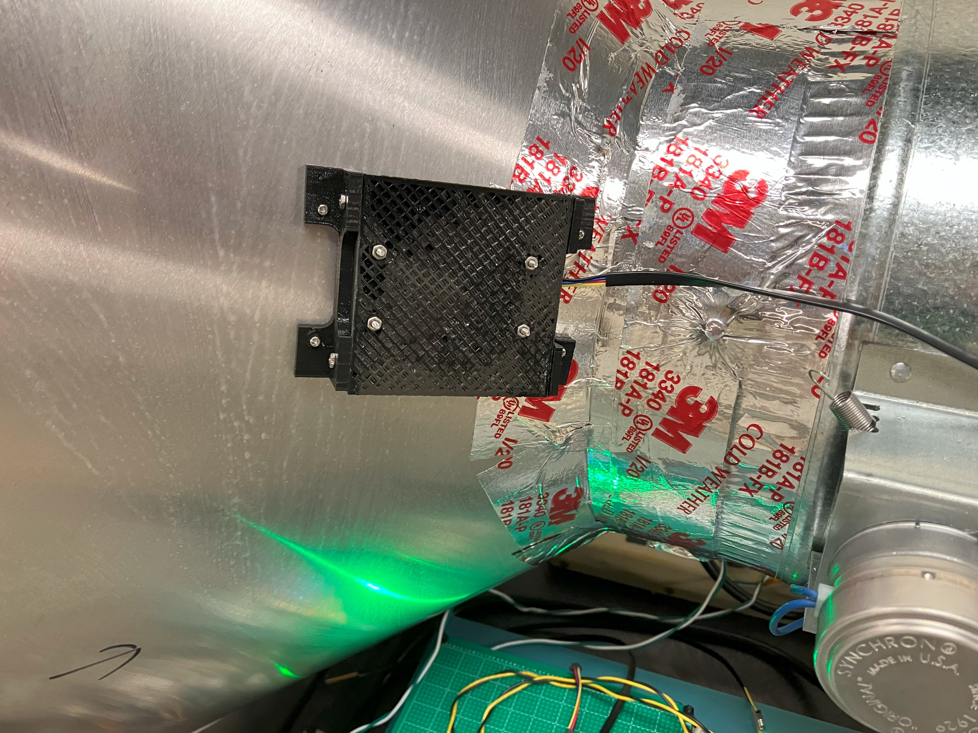
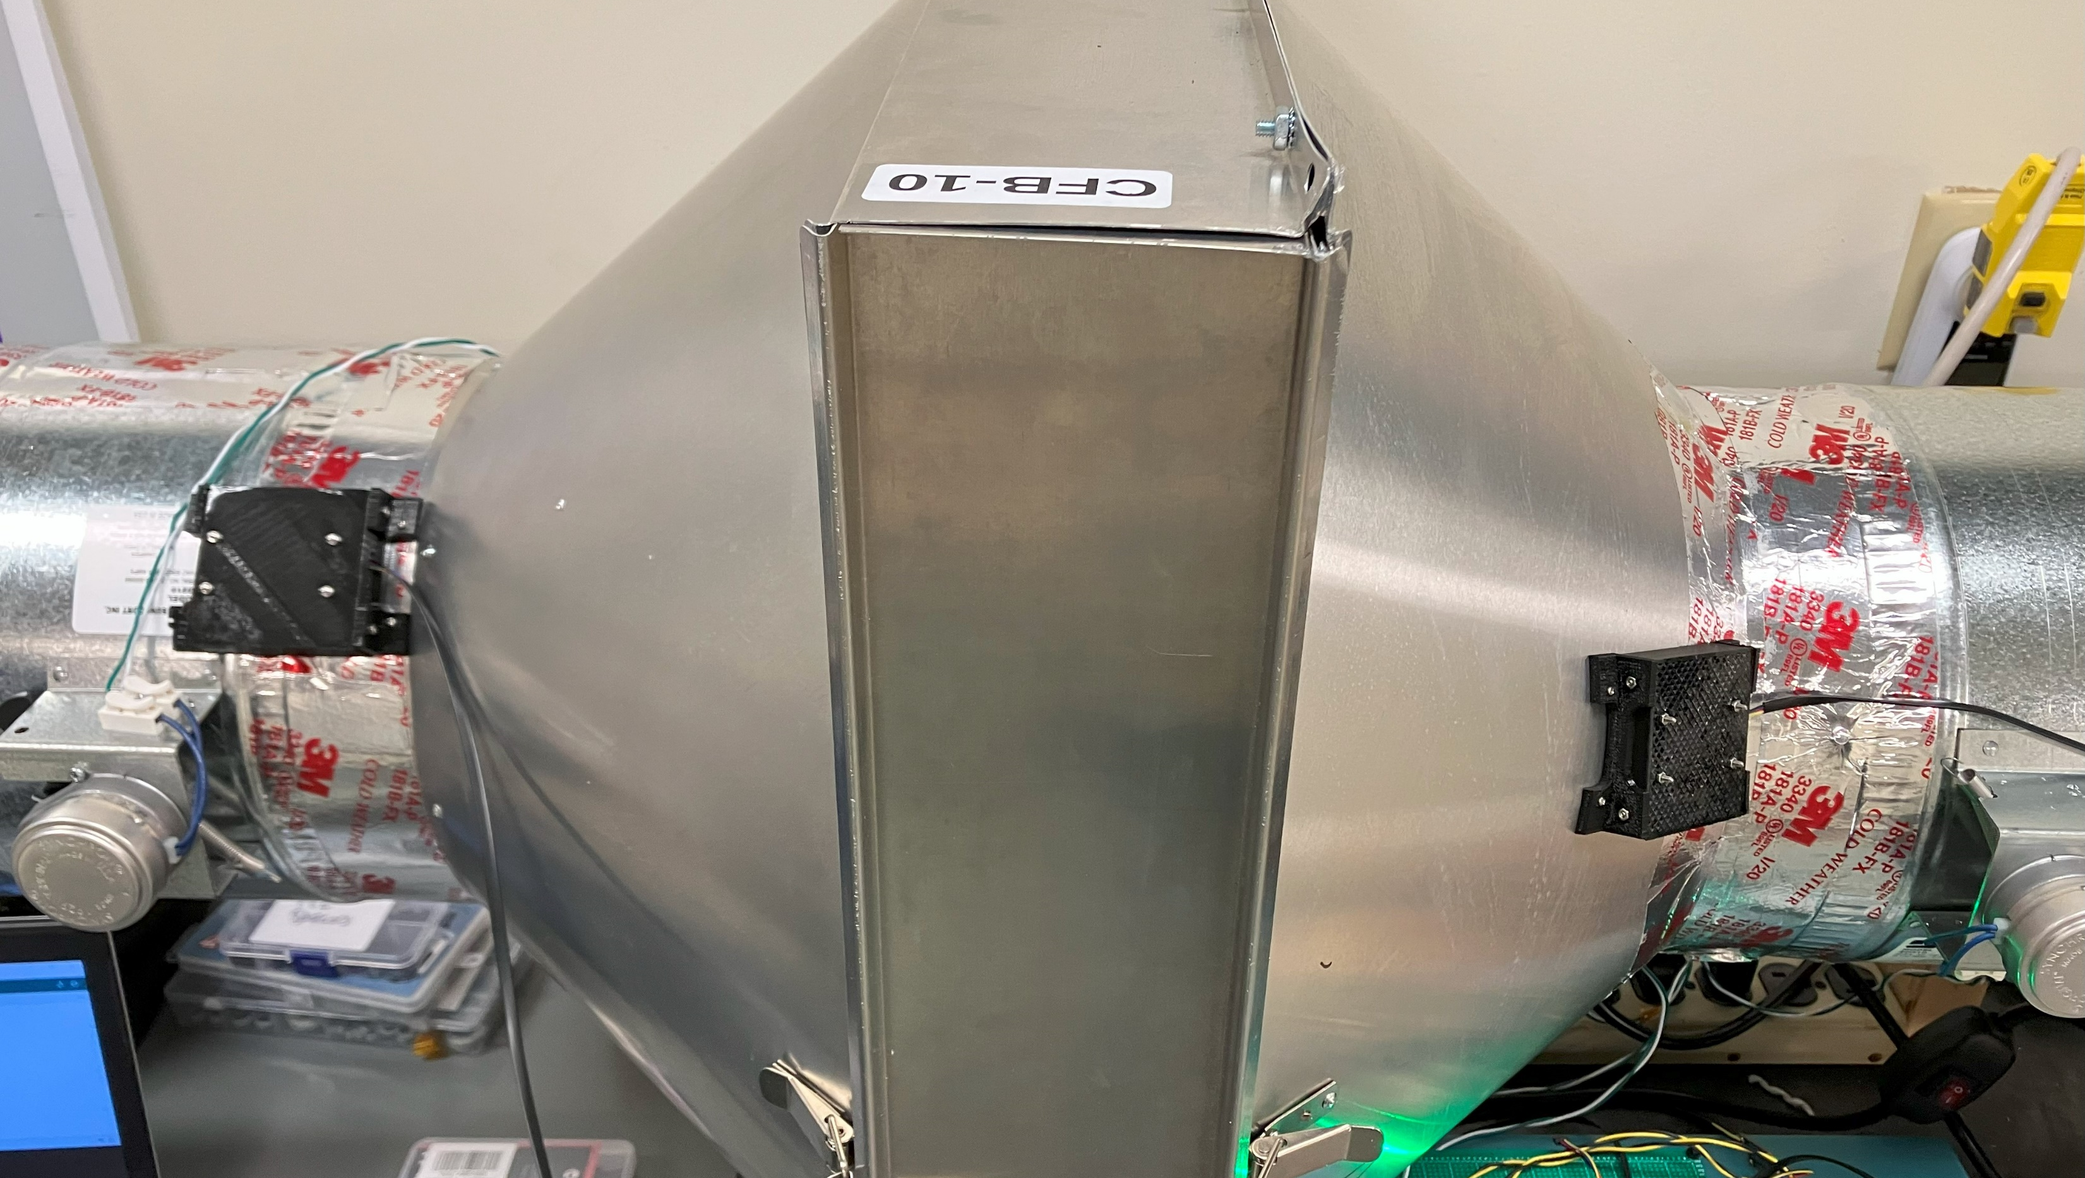
Sensors and Boxes Mounted
INPUT
OUTPUT

Slide 12
Heat Sequence for Desorption Test
Open Damper, Fan ON for 1 minute
Open Damper, Fan ON for 1 minute

Slide 13
Desorption

Slide 14
Sensor Readback Problem!

Slide 15
First CO2 Test: CO2 and H2O Release
Open Damper, Fan ON for 1 minute
Open Damper, Fan ON for 1 minute

Slide 16
Adsorption: Fan ON, Heat OFF

